Slide 1


Query Optimization
Minimizing Memory and Latency in DSMS
By
Carlo Zaniolo
CSD--UCLA
June 2009

Slide 2
Query Optimization in DBMS
In DBMS: execution time savings by selecting operator implementation indexes and join reordering--- all measured by page swap counts
Scheduling of various queries might be left up to the OS.

Slide 3
DSMS Optimization of Queries and Schedules
  In DSMS: data is in memory and execution time is mostly determined by the query graphs and the costs of tuples being processed.
  But many queries competing for resources: thus schedules must be optimized to minimize latency and memory (similarities with tasks scheduling in OS)
  Simple DBMS-like query optimization opportunities remain: e.g. pushing selection, composing views
  Sharing of operators and buffers also important!

Slide 4
Optimization by Sharing
In traditional multi-query optimization:
  sharing (of expressions, results etc) among queries can lead to improved performance
Similar issues arise when processing queries on streams:
  sharing of query operators and expressions
  sharing of sliding windows

Slide 5
Shared Predicates [Niagara, Telegraph]
>
Predicates
for R.A
7
1
11
R.A > 1
R.A > 7
R.A > 11
R.A < 3
R.A < 5
R.A = 6
R.A = 8
R.A ≠ 9
A>1
A>7
A>11
Tuple
A=8
<
3
A<3
A<5
=
6 8
≠
9

Slide 6
Optimized Scheduling for Query Graphs
Source
∑1
^{σ}
∑₂
Sink
O₂
Sink
Source
O₁
O₃
Sink
Source1
π
∑₁
Sink
U
Source2
σ
∑₂
Sink
Two main objectives:
minimizing Latency, or
Minimizing Memory
What is different w.r.t. job scheduling in OS?

Slide 7
Common Scheduling Strategies
Round Robin (RR) is perhaps the most basic
  operators in a circular queue are given a fixed time slice.
  Avoids starvation is avoided, but adaptivity, latency and memory suffer.
FIFO: takes the first tuple in input and moves it through the chain
  Minimizes latency, but not memory.
Greedy Algorithms based on Heuristics
  Buffers with most tuples first
  Tuples that waited longest first
  Operators that release more memory first

Slide 8
More Optimization Approaches
Rate-based optimization [VN02]: Overall objective is to maximize the tuple output rate for a query
Chain [Babcock 2003]: Objective is to Minimize Memory Consumption for paths
Response time minimization [BZ08]: i.e. Time from source to sink (latency)
  Maximize user satisfaction
  Natural objective except when memory is real scarce.
  A formal treatment is needed for this case, and also for more general query graph topologies.

Slide 9
Rate Based Optimization
Rate-based optimization [VN02]:
  Take into account the rates of the streams in the query evaluation tree during optimization
  Rates can be known and/or estimated
Overall objective is to maximize the tuple output rate for a query
  Instead of seeking the least cost plan, seek the plan with the highest tuple output rate.
  maximizing output rate often leads to optimum response time but optimality is not proven.

Slide 10
Chain: [Babcock et al.2003]
Objective: minimize memory usage
Optimality achieved on simple paths
  But not on more complex query graphs [Babcock et al. 2004]

Slide 11
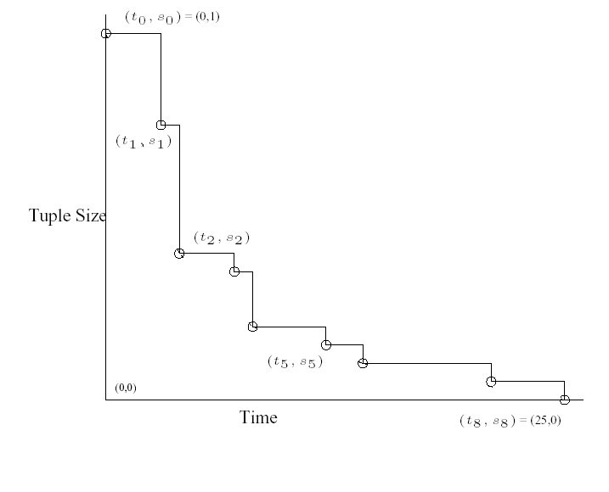
Chain: Memory Progress charts
Each step represents an operator
The ith operator takes (t_{i} – t_{i-1}) units of time to process a tuple of size s_{i-1}
Result is a tuple of size s_{i}
We can define selectivity as the drop in tuple size from operator i to operator i+1.
Source
O1
O2
O3
O1
O2
Memory used

Slide 12
Chain Scheduling Algorithm
Source
O1
O2
O3
Sink
Original query graph is partitioned into sub-graphs that are prioritized eagerly
O1
O1
Lower
Memory
Memory
O2
O2
envelope
O3
O3
Time

Slide 13
State of the Art
Chain Limitations:
  Latency minimization not supported—only memory
  Generalization for complex graphs needs more work
  Assumes that every tuple behaves in the same way
    Optimality achieved only under this assumption---what about if tuples behave differently?

Slide 14
Query Graph:
Arbitrary DAGs
Source
σ
∑₁
∑₂
Sink
O₂
Sink
Source
O₁
O₃
Sink
Source1
π
U
Sink
Source2
σ
Source1
π
∑₁
Sink
U
Source2
σ
∑₂
Sink

Slide 15
Latency and Arbitrary Graphs
The memory minimization chart partitioning approach of Chain was generalized in [Bai et al. 2008] to support:
  Arbitrary graphs
  Latency (i.e., response time) minimization
  the solution breaks up each component into a set of subgraphs and greedy optimization: subgraph with steepest slope first.
Optimal if all tuples in buffer behave the same
  only minor improvements when cost of indidual tuples are taken into account.

Slide 16
Latency: the Output Completion Chart
Example, one operator:
Total Output produced
3
2
Source
O₁
Sink
1
Time
Suppose we have 3 input tuples at operator O₁
  Horizontal axis is time, vertical axis is # remaining output to be produced
  Many waiting tuples → curve smoothes into the dotted slope
The slope is average tuple processing rate
tuple₁
tuple₂
tuple₃
Remaining Output
3
2
1
Time
tuple₁
tuple₂
tuple₃
Remaining Output
N
What is different from OS?
S
Time

Slide 17
Latency for Simple Paths
First in First Out execution strategy
Cuts only increase latency in simple paths and
DAGs with union and joins.
Source
A
B
C
Sink
A + B
A + B +C
C
A+B+ C

Slide 18
Latency Minimization: Multiple Paths
Example for latency optimization: multiple independent operators
Total area under the curve represents total latency over time
Minimizing total area under the curve—same as lower envelope
  Order operators by non-increasing slopes
Remaining Output:
A first
B first
B
S_{B}
A
S_{A}
B
A
S_{B}
Time
S_{A}
Time
Multiple Operator in parallel: still lower envelope
O₁
O₂
A:
Source
O₁
Sink
O₃
B:
O₄
Time
Source
O₂
Sink

Slide 19
Latency Optimization: Forks
  Tuples shared by multiple branches: scheduling choices at forks:
  Finish all tuples on the fastest branch first (break the fork)
    Achieve fastest rate over the first branch
  Take each input through all branches (no break)
    FIFO , achieves the average rate of all branches
O₂
Sink
Source
O₁
O₃
Sink
Partition at Fork
No Partition at Fork
2N
O₁+O₂
O₁+O₂
O₁+O₂+O₃
2N
N
O₁+O₂+O₃
O₃
N
Time
O₃
N x τ₃
Time
N(τ₁+τ₂)
N(τ₁ + τ₂+τ₃ )

Slide 20
Latency Optimization on Nested Fork
A
Sink
C
B
Sink
Source
E
D
Sink
H
Sink
G
P
Sink
Algorithm:
O
Sink
Compute productivity of current tree.
Starting from bottom sink, determine with branch should be cut—e.g. the slope O is less than that of E,G, H&P
When one can no longer cut at one level, move up to and then move up to next level of fork.
Repeat the whole process on the subtrees generated by partition. These will then be executed in the priority established by their productivity.

Slide 21
Latency Optimization on Nested Fork
E
Apply partitioning
bottom-up:
Cut above C?
yes
Cut above G?
no
Finally schedule them by their slopes
D
Remaining Output
G+H+P
C+A&B
O
A
Sink
C
B
Sink
Source
E
D
Sink
H
Sink
G
P
Sink
O
Sink

Slide 22
Latency Optimization on Nested Fork
A
Sink
C
B
Sink
Source
E
D
Sink
H
Sink
G
P
Sink
O
Sink
Apply partitioning algorithm starting from bottom
For each fork closest to sink buffers select least productive path

Slide 23
Back to Memory Optimization
Similar algorithms can be used for memory minimization
Slopes are memory-reduction rates
Forks are not broken– branches are.

Slide 24
Optimal Algorithm-Latency Minimization
Optimization so far, based on the average costs of the tuples in each buffer. Thus, the optimal sequence of buffers defines the schedule.
Scheduling based on individual tuple cost: make a scheduling decision for each tuple and the basis of its individual cost.
  Scheduling is still constrained by tuple-arrival order—thus at each step, we chose between the heads of each buffer.
  A greedy approach that selects the least expensive head is not optimal!
Source
A
Sink
Source
B
Sink
Source
C
Sink

Slide 25
Optimal Algorithm: when cost of each tuple is known
For each buffer chart the costs of the tuples in the buffer: Partion each chart into groups of tuples
Schedule group of tuples eagerly, i.e. by decreasing slope
Optimality as minimization of resulting: area = cost × time.
Source
A
Sink
Source
B
Sink
Source
C
Sink

Slide 26
Latency Optimization on Nested Fork
Recursively apply the partitioning algorithm from bottom-up
  Starting from forks closest to sink buffers
E
D
Remaining Output
G+H+P
C+A+B
O
A
Sink
C
B
Sink
Source
E
D
Sink
H
Sink
G
P
Sink
O
Sink

Slide 27
Example: Optimal Algorithm
A5,A4,A3,A2,A1
B3,B2,B1
\ /
\ /
Source
A
Sink
Source
B
Sink
_{A1}
_{A2}
_{B1}
SA1
_{B2}
_{A3}
_{A4}
SB1
_{B3}
_{A5}
SB2
Time
SA2
Time
  * Naïve Greedy would take B1 before A1
  ** Optimal Order: SA1=A1,A2,A3,A4. Then SB1=B1,B2, then SB2=B3, finally SA2=A5.

Slide 28
Example: Optimal Algorithm
A5,A4,A3,A2,A1
B3,B2,B1
\ /
\ /
Source
A
Sink
Source
B
Sink
_{A1}
_{A2}
_{B1}
SA1
_{B2}
_{A3}
_{A4}
SB1
_{B3}
_{A5}
SB2
Time
SA2
Time
  * Naïve Greedy would take B1 before A1
  ** Optimal Order: SA1=A1,A2,A3,A4. Then SB1=B1,B2, then SB2=B3, finally SA2=A5.

Slide 29
Experiments – Practical vs. Optimal
Latency
Minimization
  Over many tuples, the practical component-based algorithm for latency minimization closely resemble the performance of the (unrealistic) optimal algorithm.

Slide 30
Conclusion
Scheduling algorithms for both latency and memory optimization are unified:
  Using a generalization of the chart-partitioning method first used by Chain for memory minimization
  Also a better memory minimization for tuple-sharing forks.
These algorithms are optimal assuming uniform costs of tuples sharing the same buffer
Experimental evaluation shows that optimization based on the average costs of tuples in buffer (instead of their individual costs ) produces nearly optimal results.

Slide 31
References
[VN02] S. Viglas, J. F. Naughton: Rate-based query optimization for streaming information sources. SIGMOD Conference 2002: 37-48
[Babcock et al. 2003] B. Babcock, S. Babu, M. Datar, R. Motwani: Chain: Operator Scheduling for Memory Minimization in Data Stream Systems. SIGMOD Conference 2003: 253-264
This is the chain paper also referred as [BBDM03]
[Babcok et al. 2004] Brian Babcock, Shivnath Babu, Mayur Datar, Rajeev Motwani, Dilys Thomas: Operator scheduling in data stream systems. VLDB J. 13(4): 333-353 (2004)
[BZ08] Yijian Bai and Carlo Zaniolo: Minimizing Latency and Memory in DSMS: a Unified Approach to Quasi-Optimal Scheduling. The Second International Workshop on Scalable Stream Processing Systems, March 29, 2008, Nantes, France.

